Slide 1
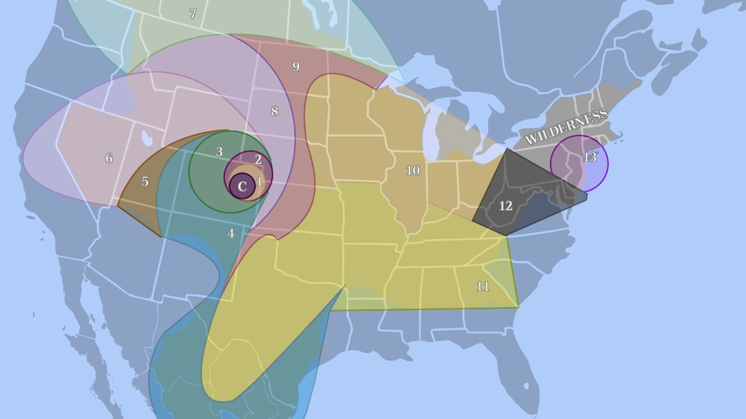
Each table is going to take on the role of one of the Districts of Panem.
You are going to spend 6 minutes creating a character from that District.
Think about:
A name which gives clues about your character’s personality
Your character’s job/interests
Your character’s family/friends
Your character’s opinion of Panem/The Capitol

Slide 2
L.O.
Create and sustain a believable character
S.C.
Consider background and history
Use dialogue to show relationships
Use asides to engage the reader

Slide 3
Shivering, from a combination of the breeze wafting in from the sea and fear at the event that was drawing closer, I crane my neck to try and get a clearer view of the people milling around on the stage.
What do we learn about this character from this descriptive extract?
Extension Task – How might you improve this description to add more information about the character?

Slide 4
Shivering, from a combination of the breeze wafting in from the sea and fear at the event that was drawing closer, I crane my neck to try and get a clearer view of the people milling around on the stage.
Why is this more effective than saying the character isn’t very tall?
Extension Task – How could you use description to show an aspect of your character from earlier?

Slide 5
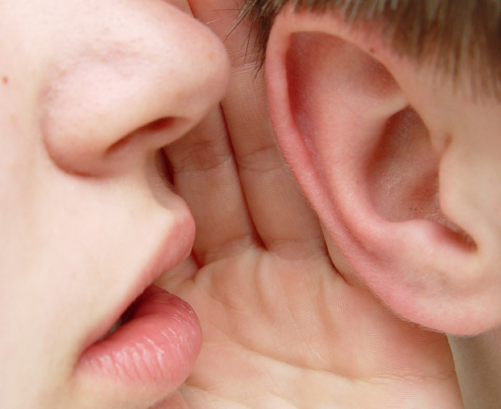
I suppose it’s obvious by now why I’m so afraid, and what is about to happen to me. I’m sure you’ve been through at least one morning like this yourself, either as a potential participant or as a nervous bystander.
What is the effect of inviting the reader into your confidence in this way?
Extension Task - Can you think of any other ways to engage the audiences’ interest in your character?

Slide 6

Write a descriptive paragraph from the viewpoint of your character as you wait for the names to be drawn in The Reaping.
Include:
Information about your district
Background information
Thoughts/feelings
Asides to the audience

Slide 7
Everything becomes still. My heart seemed to stop in my chest. We watched the stage nervously. You know the feeling, as though your whole life hangs on that one moment.
Why is it important to consider the lengths of the sentences you use?
Extension Task – How else could you build tension in a piece of description?

Slide 8
Continue your paragraph, building up tension to the moment where the first name is drawn from The Reaping.
Include?

Slide 9
“Don’t watch the games unless you have to...” I pleaded.
“I’ll be fine.”
“I’ll b-” My words caught in my throat as I imploded under the pressure.
What sort of relationships/characters would speak these lines of dialogue?
Extension Task – Write a reply to each of these which shows us the other character.

Slide 10
Write a goodbye conversation between your character and a family member/close friend.
Use dialogue to show us what the relationship is like.
Remember:
- “Hello.”
- Start a new line each time someone new is speaking

Slide 11

Highlight one example of where they have:
Included character background/history
Shown us something rather than telling us
Used dialogue to show character
Used speech punctuation correctly
Used asides to engage the reader
Have they met today’s L.O.?
What do they still need to improve on?

